Slide 1
Crack Online Web Form Passwords with Burp Suite & Hydra
https://null-byte.wonderhowto.com/how-to/hack-like-pro-crack-online-web-form-passwords-with-thc-hydra-burp-suite-0160643//

Slide 2
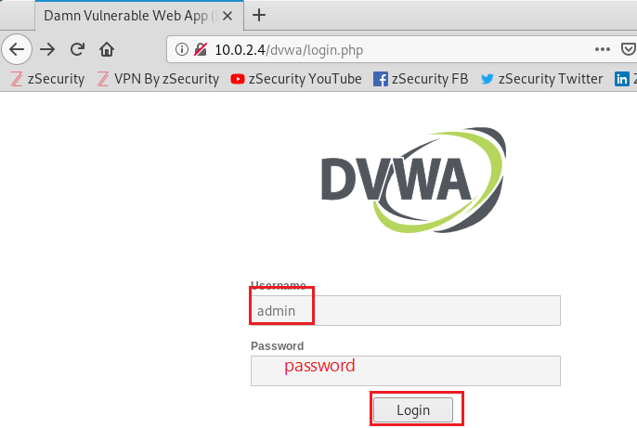
Our goal : Damn Vulnerable Web App (DVWA)

Slide 3
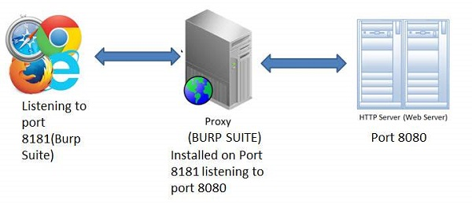

Architecture
1. Capture authentication URL
2. Brute force using dictionary with the URL
Hydra

Slide 4
Overview
Burp Suite
Hydra
Crack web password

Slide 5
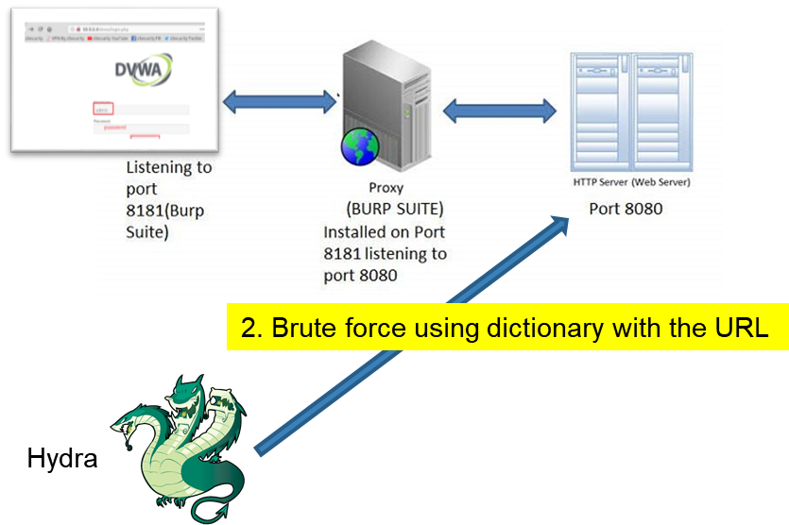
Burp Suite
A Java based Web Penetration Testing framework.
Can be classified as an Interception Proxy
(sort of) Man In The Middle by capturing and analyzing each request to and from the target web application
request and response can be analyzed and manipulated.

Slide 6
Hydra
Online password cracking tool
Perform rapid dictionary attacks against more than 50 Protocols, including Telnet, RDP, SSH, FTP, HTTP, HTTPS, SMB, several databases and much more.

Slide 7
Crack DVWA Web Password

Slide 8
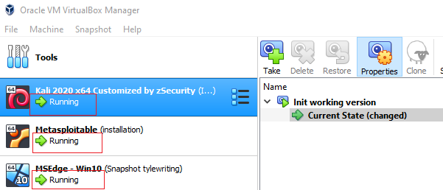
Start two VMs
 | Username | Password
Kali | root | toor
Metasploitable | msfadmin | msfadmin
Win 10 |  | Passw0rd!

Slide 9
Set up Burp

Slide 10
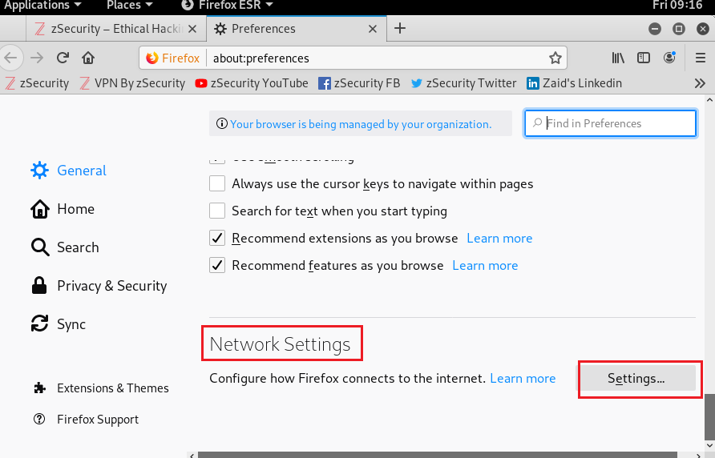
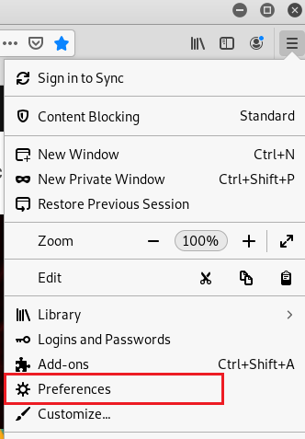


Slide 11
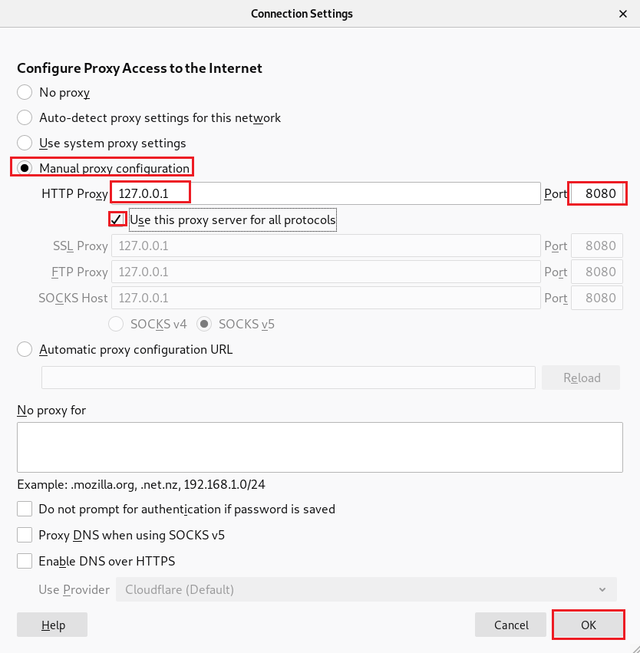

Slide 12
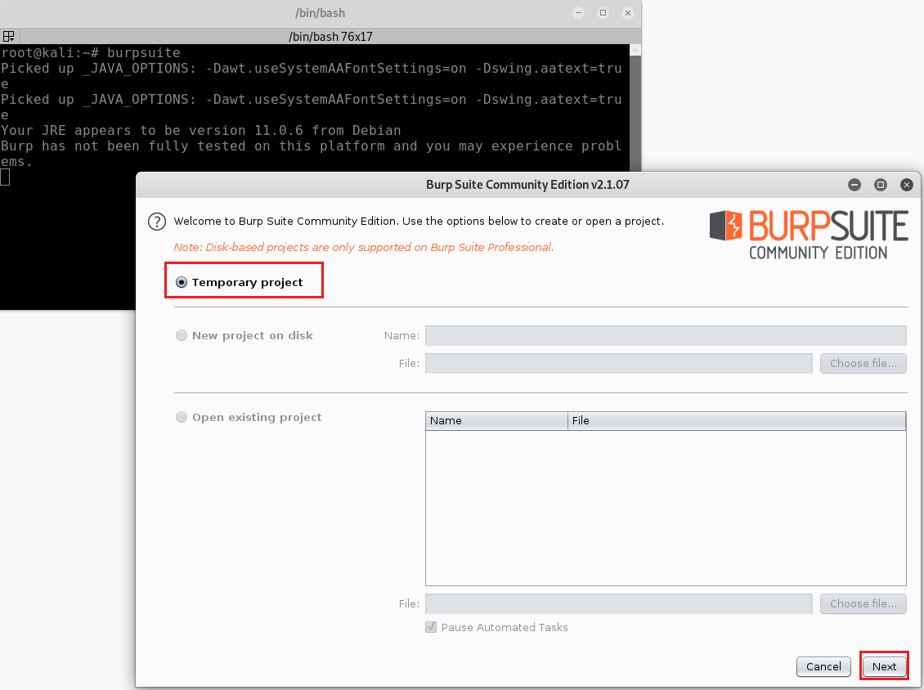
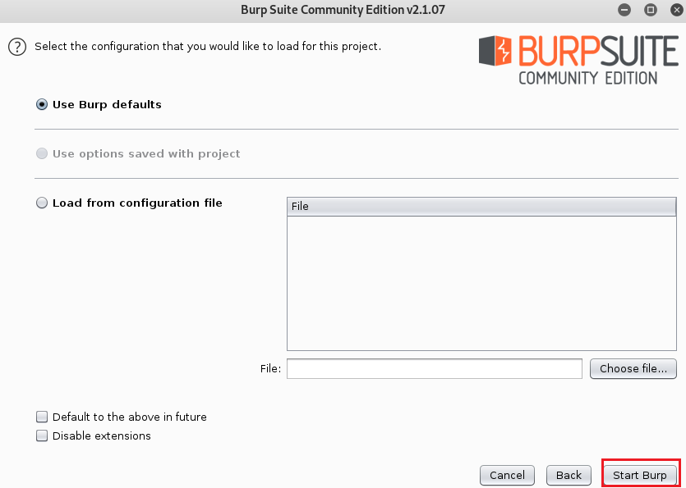

Slide 13
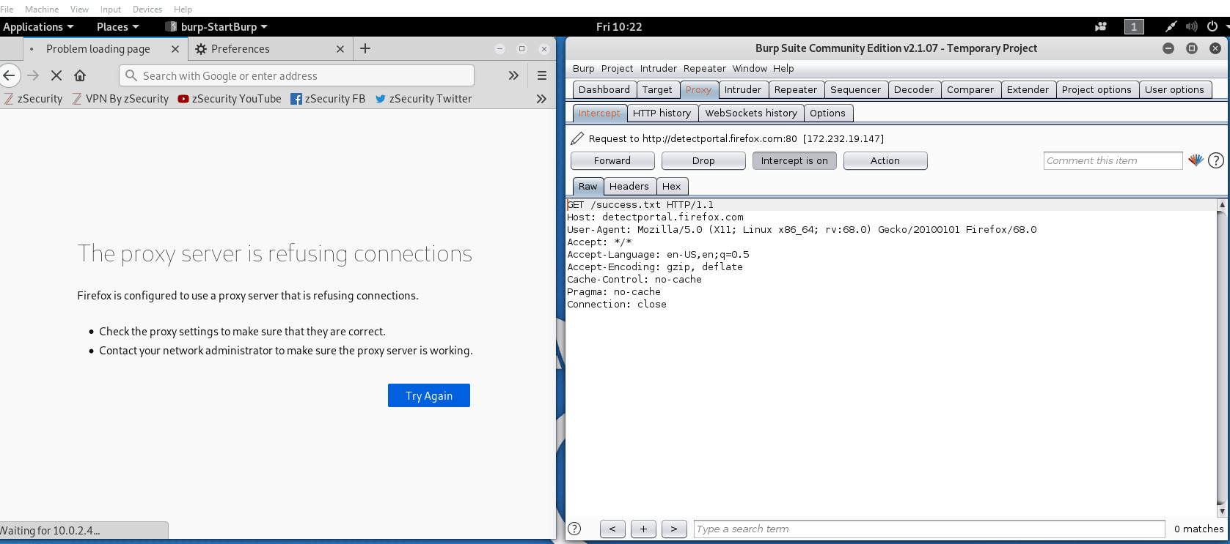
Capture web authentication URL

Slide 14
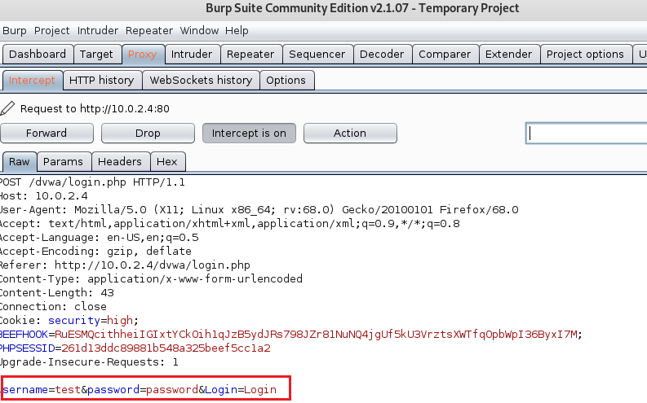

Slide 15
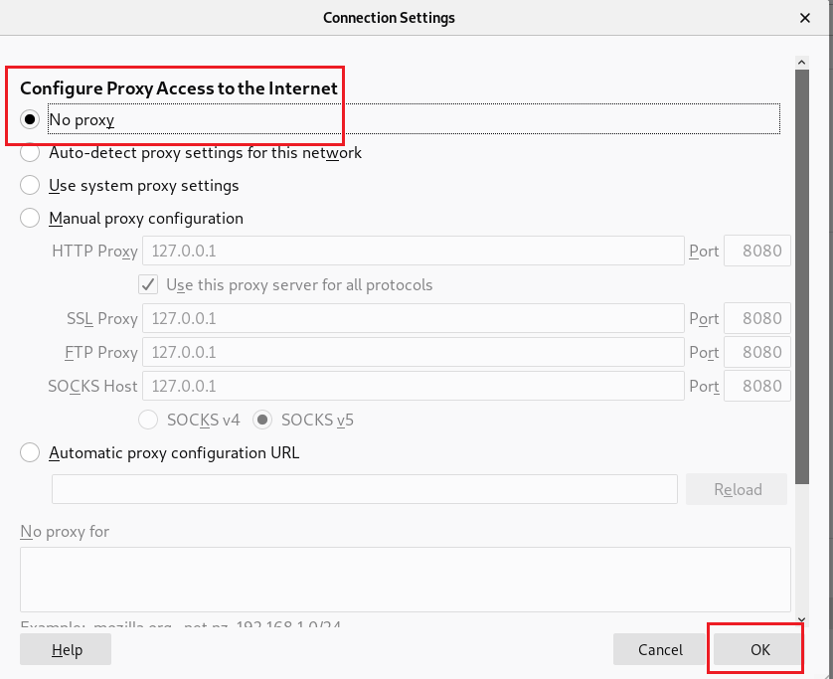
Remember to rollback your setting back
Otherwise your browser won’t work
Network setting
Burpsuite

Slide 16
Use Hydra
Dictionary attack

Slide 17
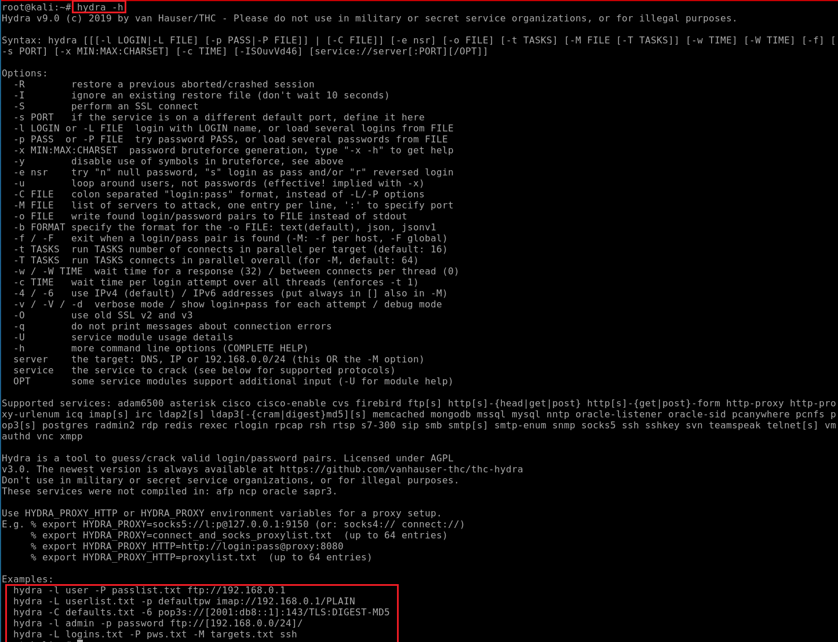

Slide 18
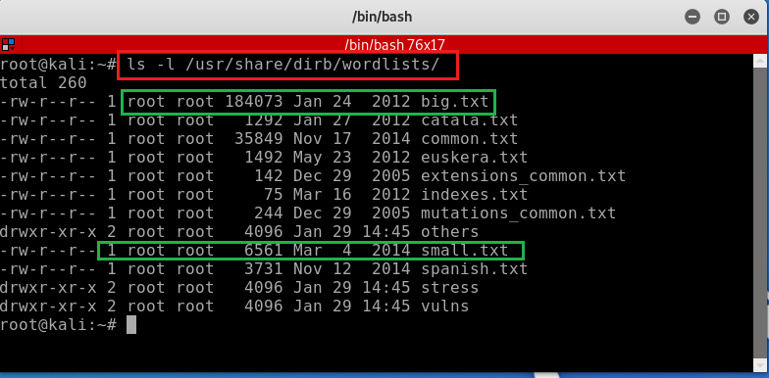

Slide 19
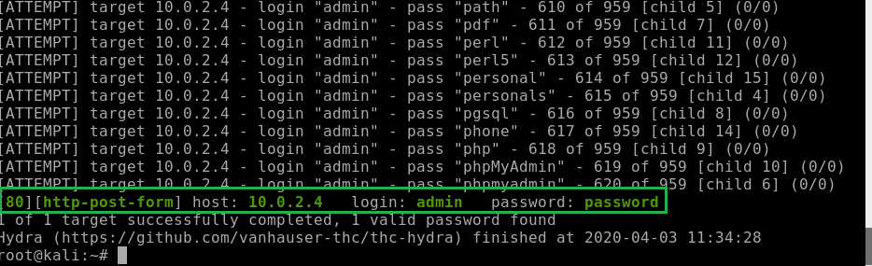
hydra -l admin -P /usr/share/dirb/wordlists/small.txt 192.168.1.101 http-post-form "/dvwa/login.php:username=^USER^&password=^PASS^&Login=Login:Login failed" -V

Slide 20
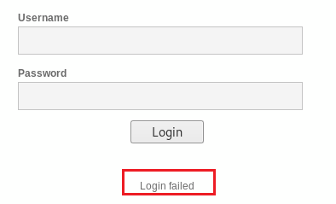
hydra -l admin -P /usr/share/dirb/wordlists/small.txt 192.168.1.101 http-post-form "/dvwa/login.php:username=^USER^&password=^PASS^&Login=Login:Login failed" -V
-l indicates a single username (use -L for a username list)
-P indicates use the following password list
http-post-form indicates the type of form
/dvwa/login-php is the login page URL
username is the form field where the username is entered
^USER^ tells Hydra to use the username or list in the field
password is the form field where the password is entered (it may be passwd, pass, etc.)
^PASS^ tells Hydra to use the password list supplied
Login indicates to Hydra the login failed message
Login failed is the login failure message that the form returned
-V is for verbose output showing every attempt

Slide 21
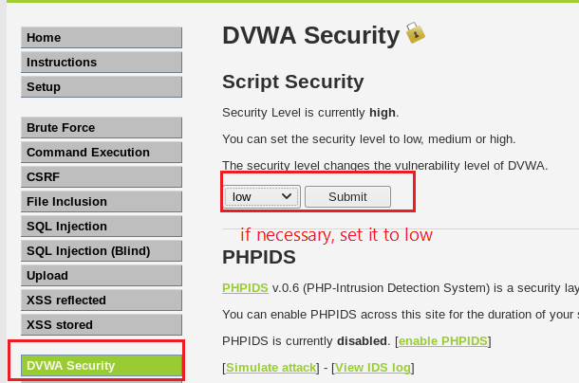
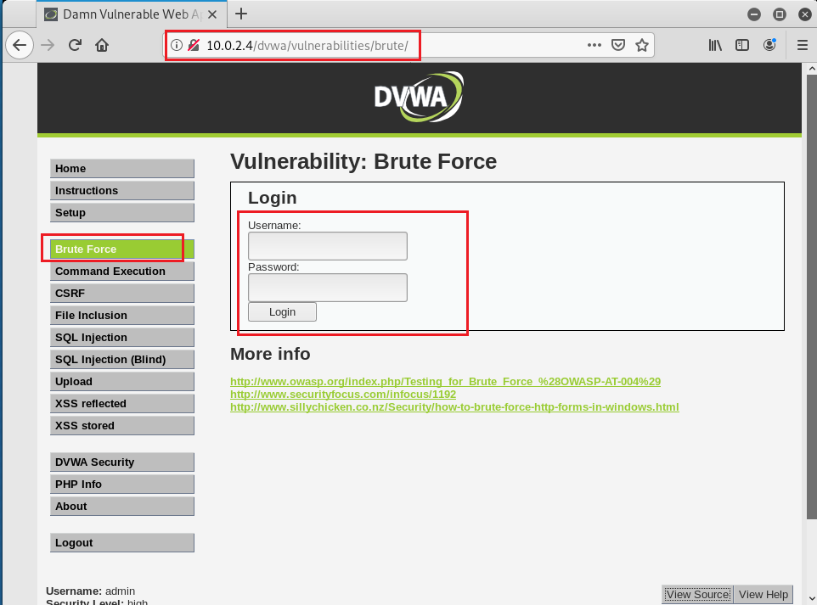
Your work

